Slide 1



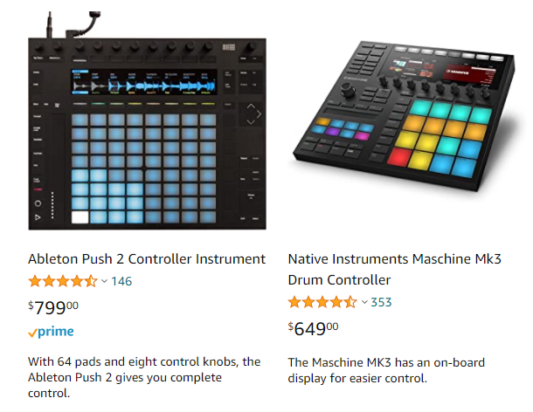
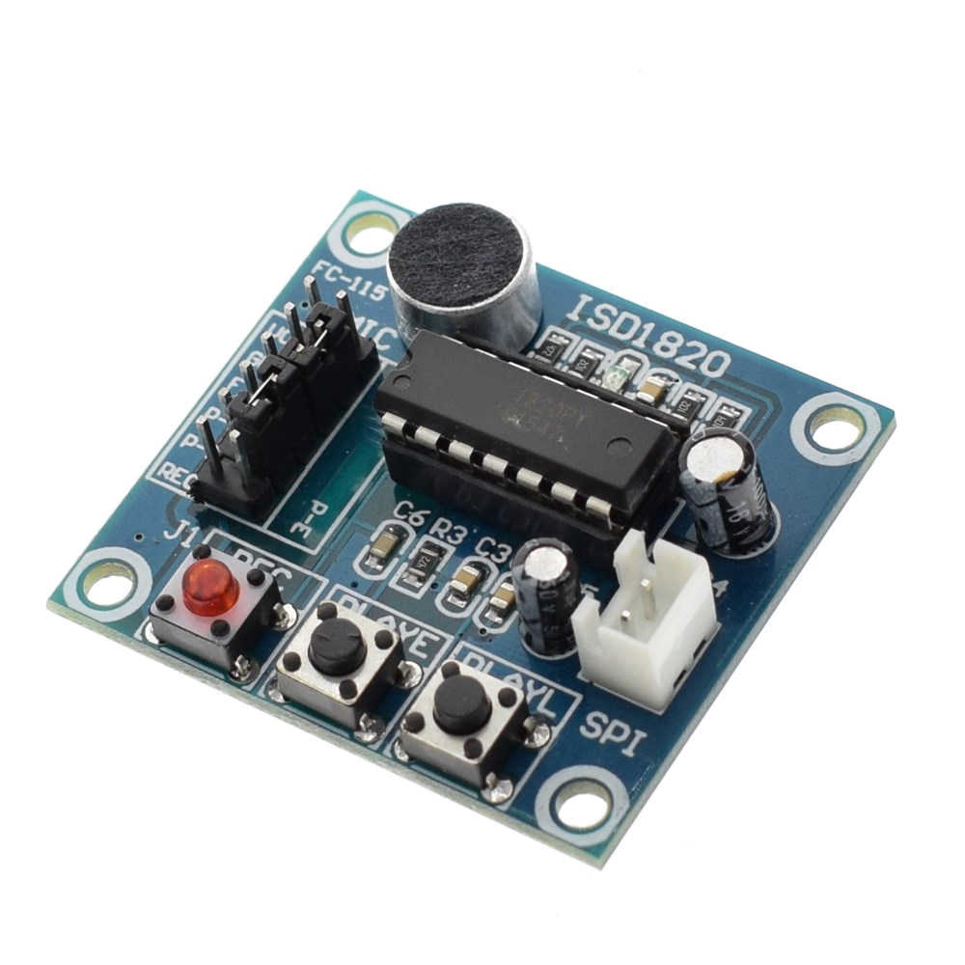
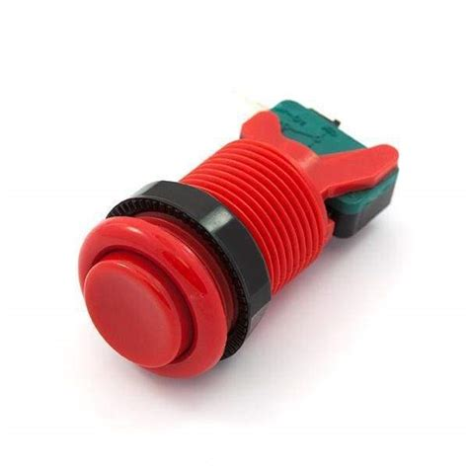
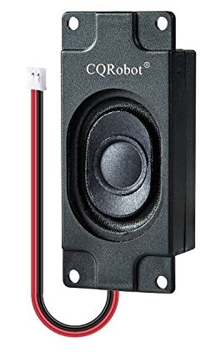
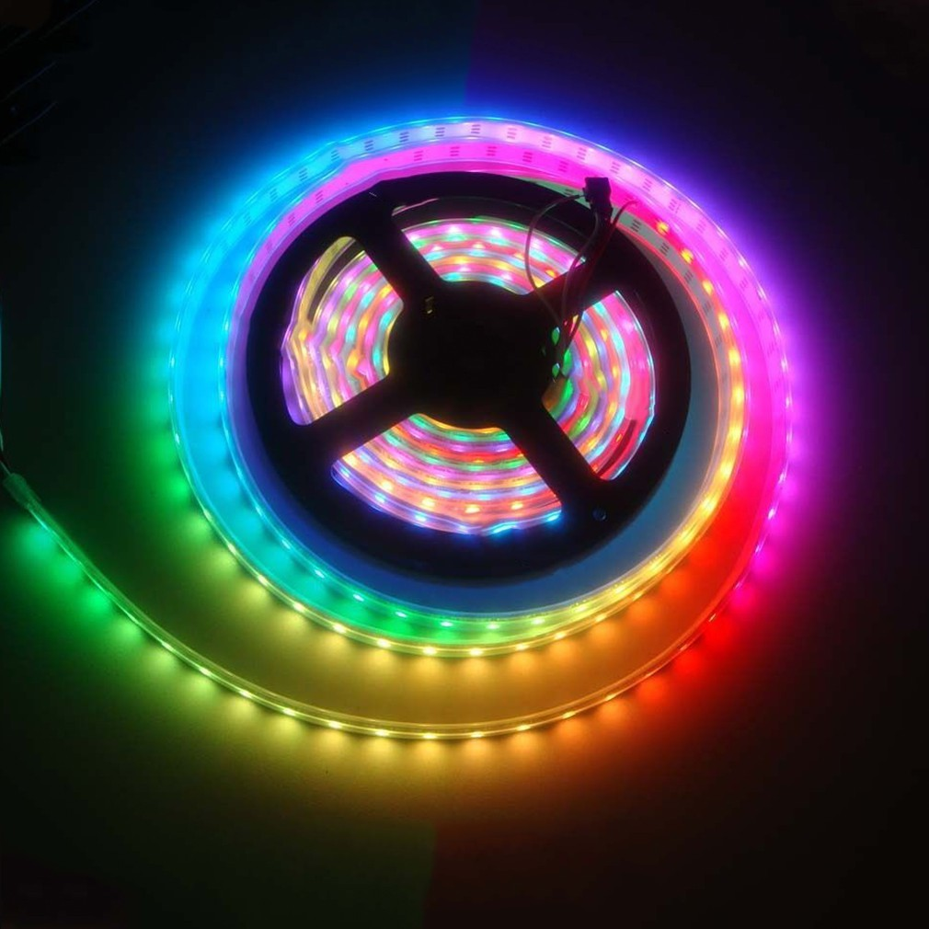
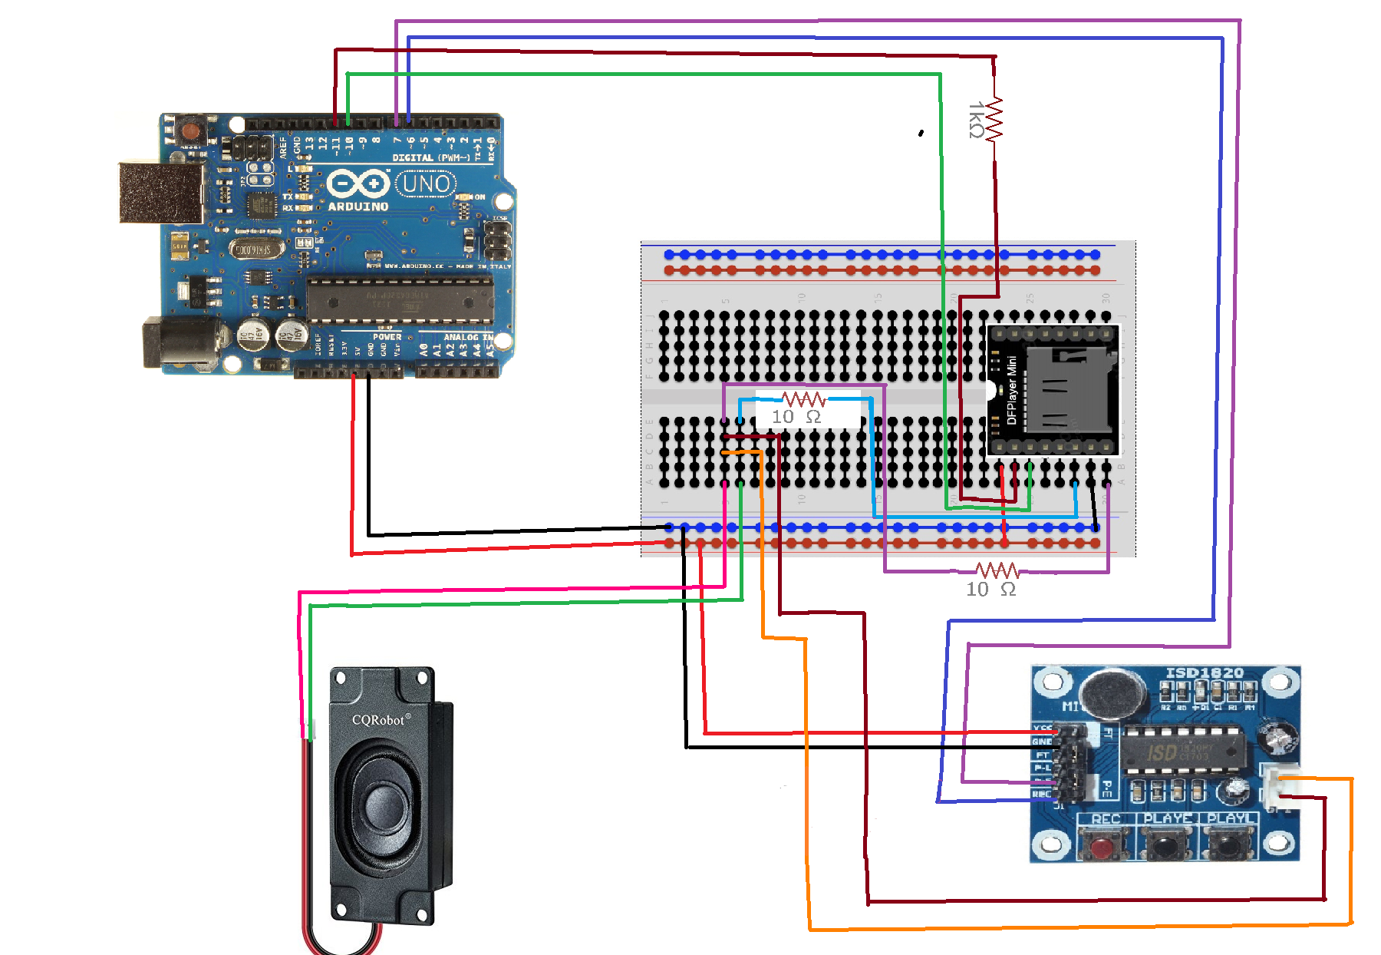

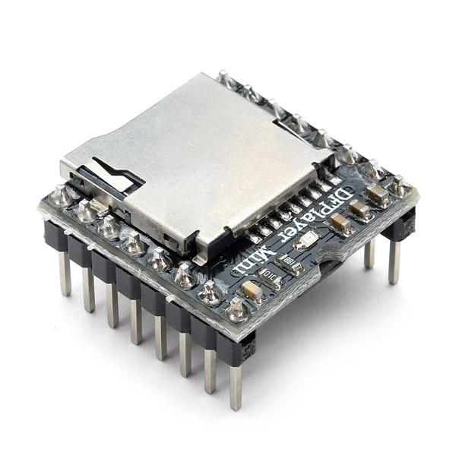
Embedded System: Sound Board
By: Alexander Mitchell
Advisor: Dr. Choi
ECE Department, School of Engineering,
Mercer University, Macon, GA
INTRODUCTION/PROBLEM
Sound boards, or stream decks, are used to provide musicians and other entertainers with a device capable of playing recorded sounds and, in many cases, adjust the quality and volume of those sounds. These are, however, very expensive. The goal of this project was to construct a sound board with reduced functionality at a vastly reduced cost. The goal was to build a board capable of playing sounds that had been recorded live, in addition to pre-recorded sounds.
Figure 1: Some sound boards and their prices on Amazon
INPUTS & OUTPUTS
The inputs to the sound board were as follows:
Sound (captured from an ISD1820 microphone) to allow for live recording
An array of buttons and potentiometers, which the Arduino used to control the DF Player Mini, ISD1820’s, and WS2812B LED strip.
The outputs were as follows:
Sound, which is played by the CQRobot speaker, note that pre-recorded sounds can have their volume adjusted.
LEDs, the WS2812B LEDs are individually controllable. The Arduino Uno uses a potentiometer to adjust the colors displayed by the lights.
Figure 2: The projects primary input and output components.
Top Left: ISD1820 Top Right: Arcade button
Bottom Left: CQRobot Speaker Bottom Right: WS2812B LEDs
CIRCUITRY/ADDITIONAL COMPONENTS
In order to keep the image below legible and simple, only major components with less intuitive wiring are shown.
Other major components of this project included the Arduino Uno, which was used as the controller for this project. As such, all code was written in Arduino IDE. The DF Player Mini was used with a micro SD card as the main MP3 player for this project, and is responsible for all pre-recorded sounds.
Figure 3 (to left): Circuit Diagram detailing most major components
Figure 4: Arduino Uno
Figure 5: DF Player Mini
RESULTS/CONCLUSIONS
All project goals were completed. The sound board is capable of playing back pre-recorded sounds, as well as sounds that have been recorded live. The volume at which sounds are played back is controllable.
The LED strip displays the intended pattern and the colors it presents are controllable, allowing for anything between a continual “wave” of color changes, to a “pulsing” of the lights.
Thus, all system verification and testing was successful. Every part is working as intended, and I am satisfied with the final product.
Working on this project has been an enjoyable experience. As such, I will continue to expand upon it in the future.
The first major planned expansion is more of this project is more of an adjustment. I would like to, at some point, exchange the live recordings for more pre-recorded songs or sound effects. I would also like to expand the functionality of the LED strip, potentially adding new patterns.
Acknowledgements
I want to sincerely thank Dr. Choi for advising me throughout the project. I would also like to thank NASA for their support.
Mercer University School of Engineering 2021

